Slide 1
Cyber-Knife
Atharva Paralikar Sameep Pote
117396560 118218427

Slide 2
What is CyberKnife?
CyberKnife is a non-surgical Robotic Radiosurgery system that destroys tumors using highly precise, targeted radiation, with minimal damage to surrounding healthy tissue.
Unlike traditional radiation therapy that can take multiple sessions, this therapy is complete in fewer sessions.
This therapy is as effective as other radiation therapies but without the side-effects. This is a simple painless process and patients can resume normal activity almost immediately.

Slide 3
Motivation
Surgical Robots have gained prominence in recent years due to their accuracy, repeatability and robustness.
Cyber-Knife used in radio surgery has numerous advantages hence studying it is necessary and important.
Due to the need of multiple orientations, this problem is a good lesson in handling such real-world problems.

Slide 4
System Requirements
Be able to vector in the laser on the object within workspace in multiple orientations
1
Be accurate enough for medical applications
3
The robot arm should be able to position itself without hitting the workspace
2

Slide 5
Design & Calculations
SolidWorks Design, D-H Parameters, Forward Kinematics, Inverse Kinematics

Slide 6
Assumptions and Derived Requirements
5-DoF Custom-designed Robotic Arm resembling actual Cyber-Knife. End effector laser
1
The lengthy point of the end-effector is the representative laser beam, and the length of which is arbitrarily assumed to be 700mm.
3
We assume that the object is placed at a fixed point in the task space during the entire operation.
2
The X-Ray in actual Cyber-knife is replaced by a LiDAR to get position of the representative object.
4

Slide 7
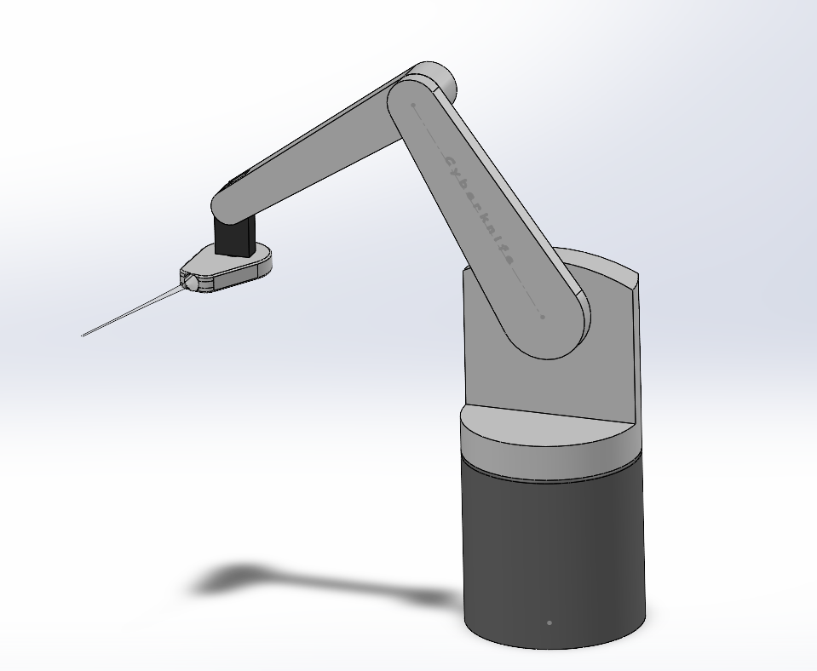
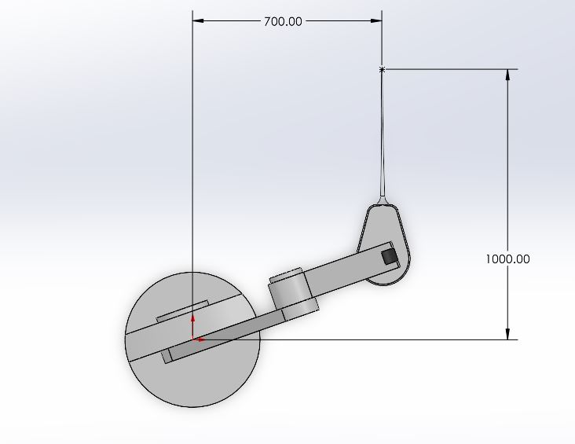
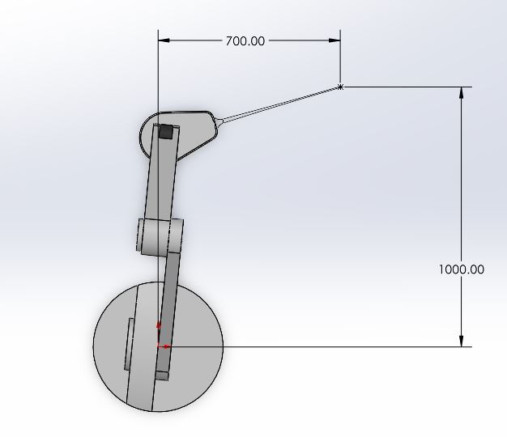
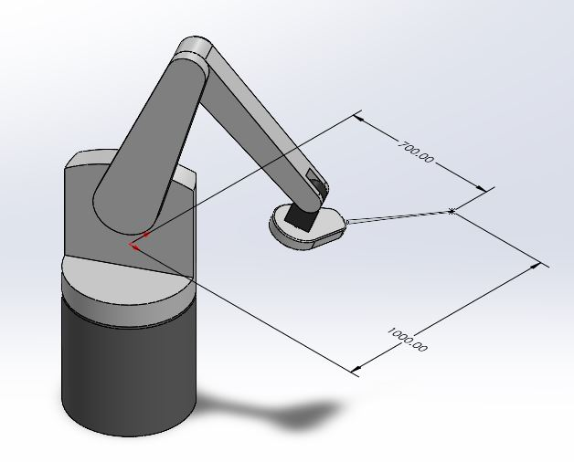
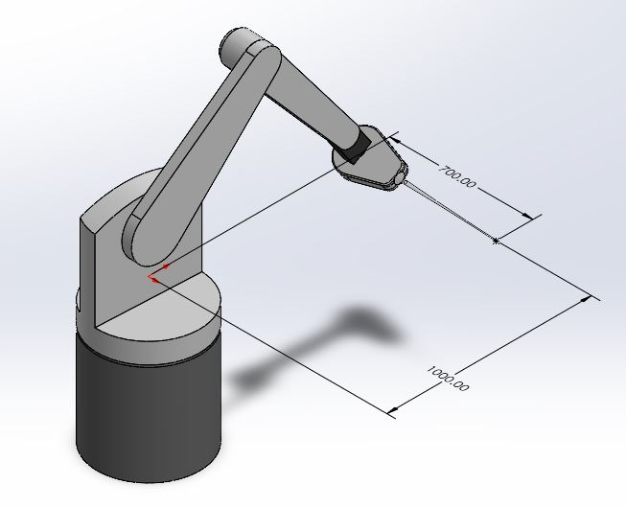
Design

Slide 8
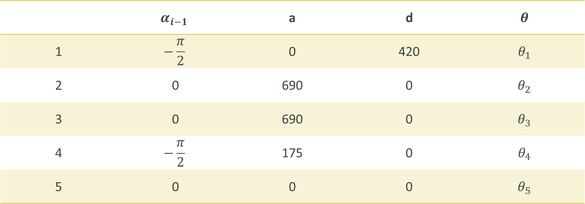
Denavit-Hartenburg Parameters
 | $$α_{i−1}$$ | a | d | $$θ$$
1 | $$−\frac{π}{2}$$ | 0 | 420 | $$θ_{1}$$
2 | 0 | 690 | 0 | $$θ_{2}$$
3 | 0 | 690 | 0 | $$θ_{3}$$
4 | $$−\frac{π}{2}$$ | 175 | 0 | $$θ_{4}$$
5 | 0 | 0 | 0 | $$θ_{5}$$

Slide 9
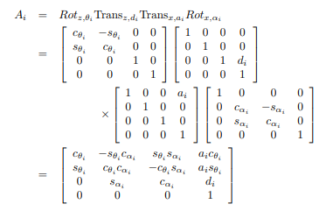
Forward Kinematics
Divided the robot into two parts – Robotic Arm and the LASER.
Used Sponge’s Transformation Matrix for calculating the end position.
Then used calculated the tool orientation.

Slide 10
Inverse Kinematics
We calculated the inverse kinematics using Euler angles as mentioned in Sponge.
Further we equated the x, y, z equation obtained by FK with desired end effector coordinates

Slide 11
ROS Simulation
Simulation using Gazebo and RViz

Slide 12

Video of ROS Simulation

Slide 13
Working of the System
Get Object Coordinates using LiDAR.
Solve IK to find Path and Joint angles.
Use FK to reach position and follow the trajectory.
Aim LASER at object from various angles.

Slide 14
Individual Contribution

Slide 15
Bibliography
M. Spong, S. Hutchinson, and M. Vidyasagar, Robot Modeling and Control. New York: Wiley, 2006.
Sun Young Noh, Kyungmin Jeong, Yong-chil Seo, Chang-hoi Kim, Jong won Park, Yoo Rark Choi, Sung Uk Lee, Yeong - Goel Bae, Seung Kim, "Development of a Prototype Robotic System for Radiosurgery with Upper Hemispherical Workspace", Journal of Healthcare Engineering, vol. 2017,Article ID 4264356, 9 pages, 2017. https://doi.org/10.1155/2017/4264356
https://www.accuray.com/cyberknife/
https://wiki.ros.org/

